Slide 1
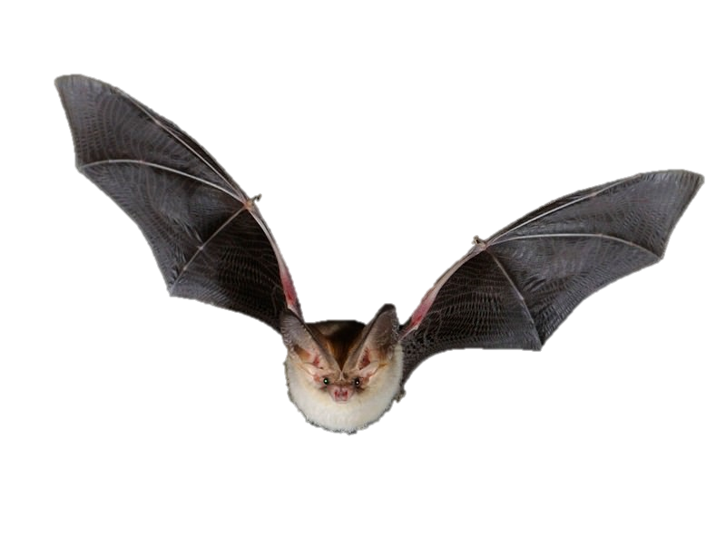
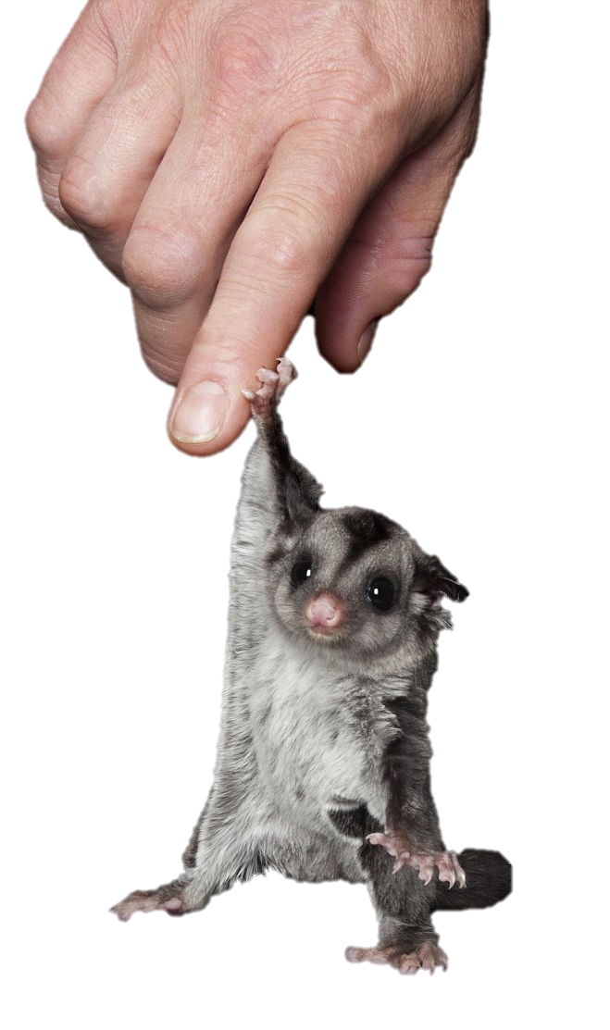
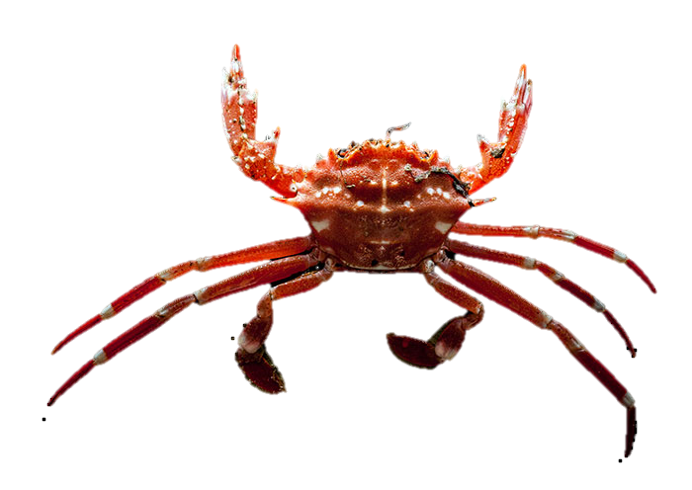
Bio-Inspired
Gliding/Walking Robot
Notes:
Image Credit: https://www.reddit.com/r/photoshopbattles/comments/652mx0/psbattle_sugar_glider_holding_on_to_a_finger/

Slide 2





The Team
MIDN 1/C
Isabelle Babb
Systems Engineering
“The Head”
MIDN 1/C
Angela Deniega
Systems Engineering
“The Heart”
MIDN 1/C
Daniel Iskandar
Systems Engineering
“The Eyes”
MIDN 1/C
Emily Peterson
Systems Engineering
“The Fist”
Professor Evangelista, Ph.D.
WSE Department
“The Looks”
In the Weapons and Systems Engineering Department, biologically inspired projects are considered especially interesting. At USNA, the dedicated midshipmen who investigate these natural phenomena are members of an elite squad known as the The Bio-Inspired Capstone. These are their final designs.
Notes:
-Law and Order inspired

Slide 3
Problem Statement
BLUF: Make a robot that can glide and maneuver in the air, transition its motion and consequently be able to travel on the ground after it lands.
Uses same mechanical features to walk and glide
- Inspired by animal movement (crabs, bats, sugar gliders).
- Future ability for load carry and enhanced navigation
Full Problem Statement:
To research animal movement, specifically that of crabs, bats, sugar gliders and flying lizards, in order to inspire, design, and create a self-stabilizing aerial robot. This system will be capable of gliding, aerial maneuvering, navigation, and landing safely on the ground. In the future additions will be made to capabilities such as walking and heavy load carry.
Notes:
-Summary for classroom/casual atmosphere, highlights key points
Image Credit: https://www.youtube.com/watch?v=sZ-PzBRSPsw (cover pic for video)

Slide 4
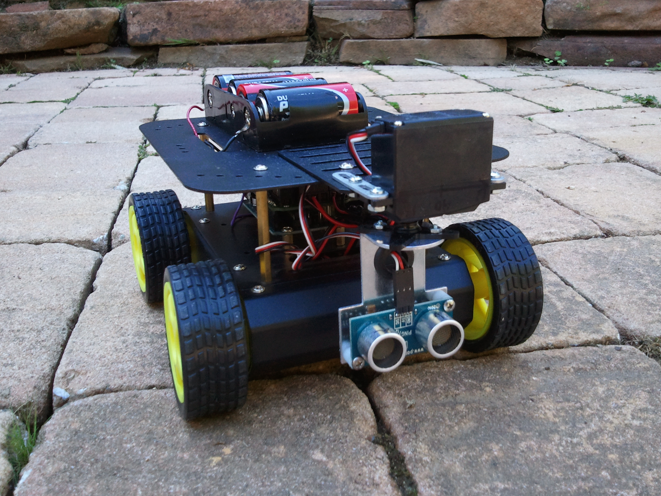

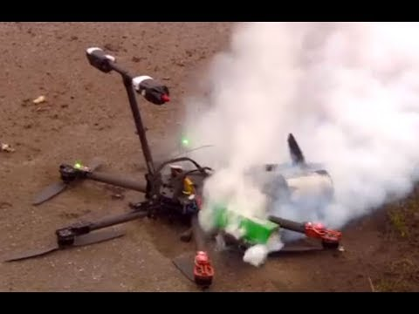
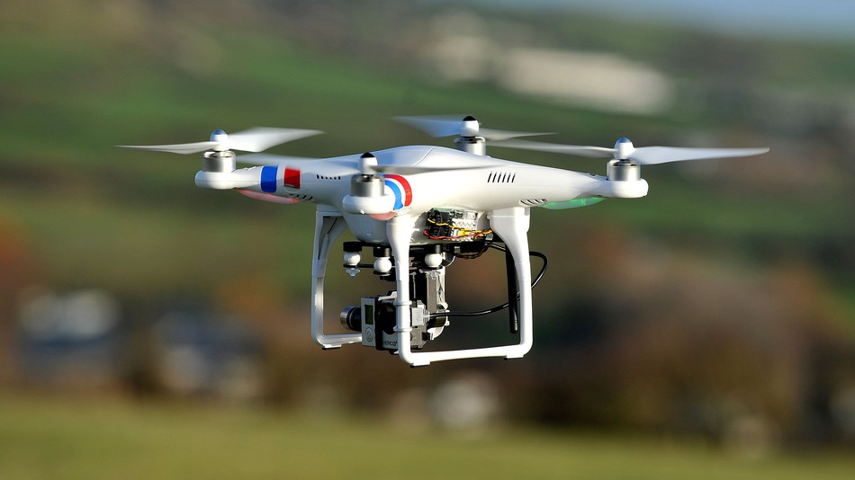
Challenges with Traditional Robots

Slide 5
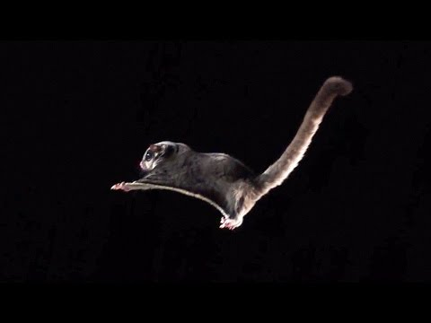
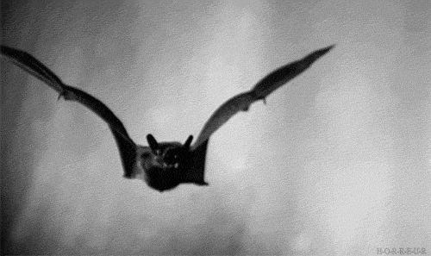
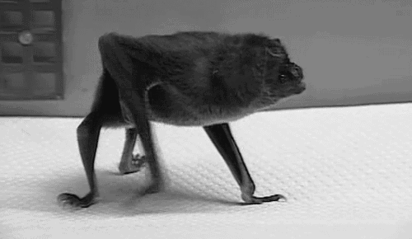
Why Bio-Inspired?
Animals are often multimodal
Nature can create robust designs
Natural selection goes with the options that work - suited to an experimental project

Slide 6
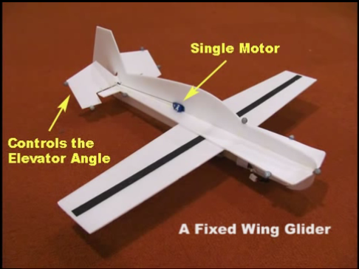
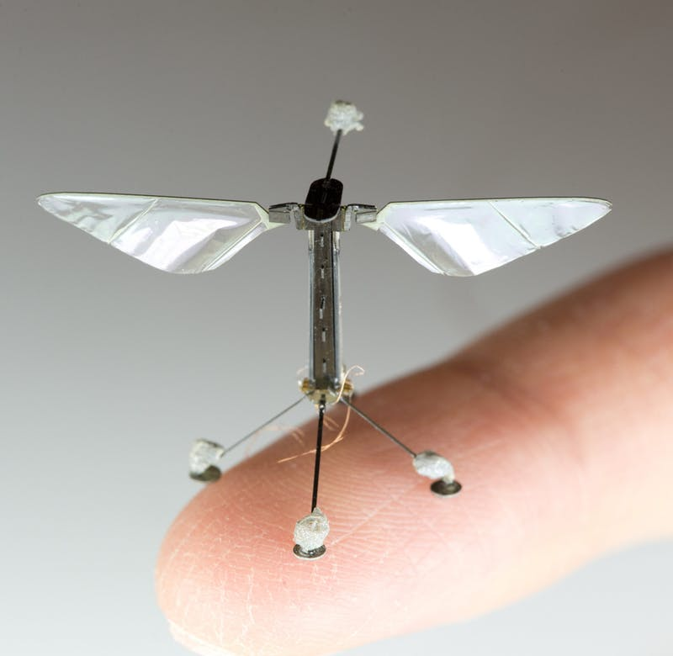
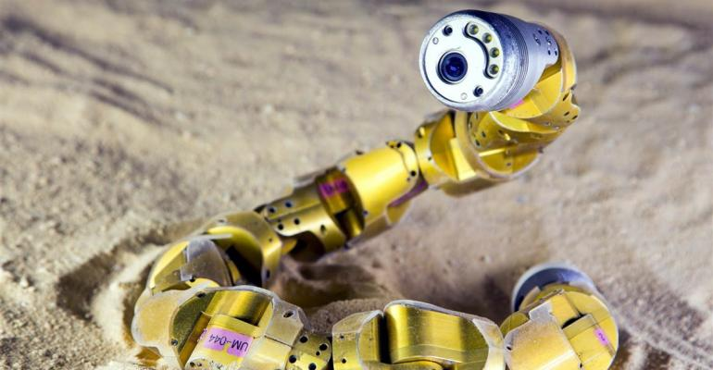
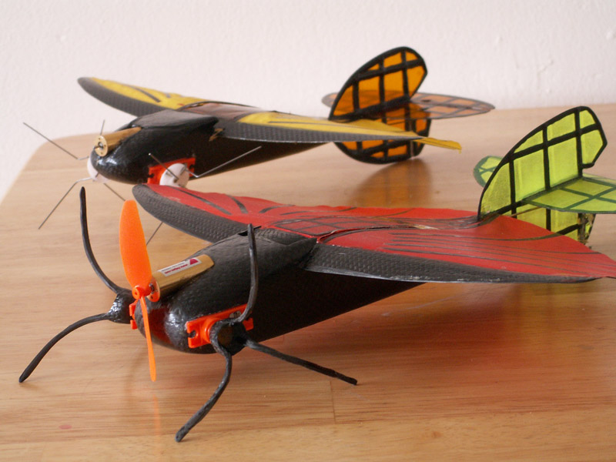
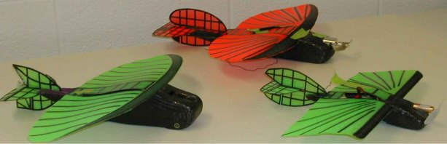
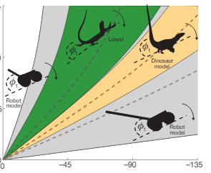
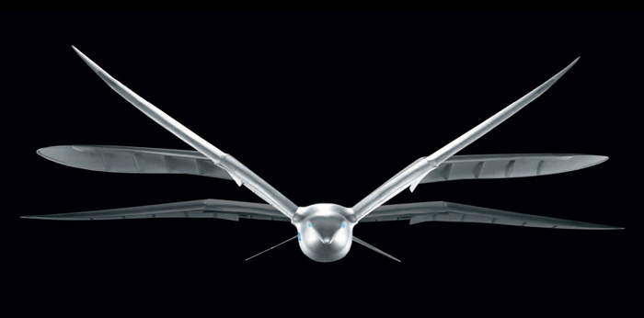
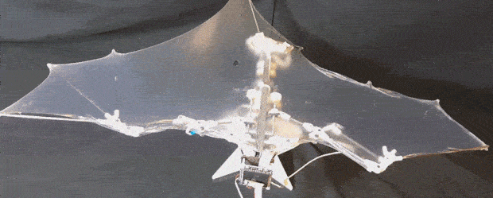
Background Research
Ex. 1 Morphing Air-Land Vehicle
Ex. 2 Bat Bot
Case Western Reserve University
- Navigates both air and land
- Carbon fiber, with fabric wings.
- UF-MAV - Mini-Whegs
- Manually controlled,
future intent of being semi/fully autonomous
CalTech and University of Illinois
Bat wings: “Metamorphic musculoskeletal system that has more than 40 degrees of freedom”
→ Reduced to 5 in BatBot
Replicates 57% of actual bat’s movement
Notes:
Full scope of research: (pictures are just cool for audience to look at rather than a ton of words)
--go in depth on all topics below:
Bio-Inspired Design
Tail-Assisted Pitch Control in Lizards
DASH Robotics
Perching Glider
Autonomous Flying Microbots
Morphing Micro Air and Land Vehicles
Robo-Raven
Bat Bot
Robert Dudley (flight patterns, dropping birds)
Glider and Aerial Mobility
Morphing Micro Air and Land Vehicles
Fiber Glider
Robo-Raven
Landing and Navigation
Perching Glider
The Freefall Camera
Morphing Micro Air and Land Vehicles
Performance analysis of jump-gliding locomotion for miniature robotics
Robert Dudley (flight patterns, dropping birds)

Slide 7
Metrics and Goals
Mobile Performs both gliding and walking movements
Controllable System responds to user in real time
Simple All parts are easily replaceable and installed w/o a manual
Reliable System performs the same steps and task every time
Durable Can withstand repeated 2 story drops and still be functional
Inexpensive Each model costs less than 80% of original budget

Slide 8
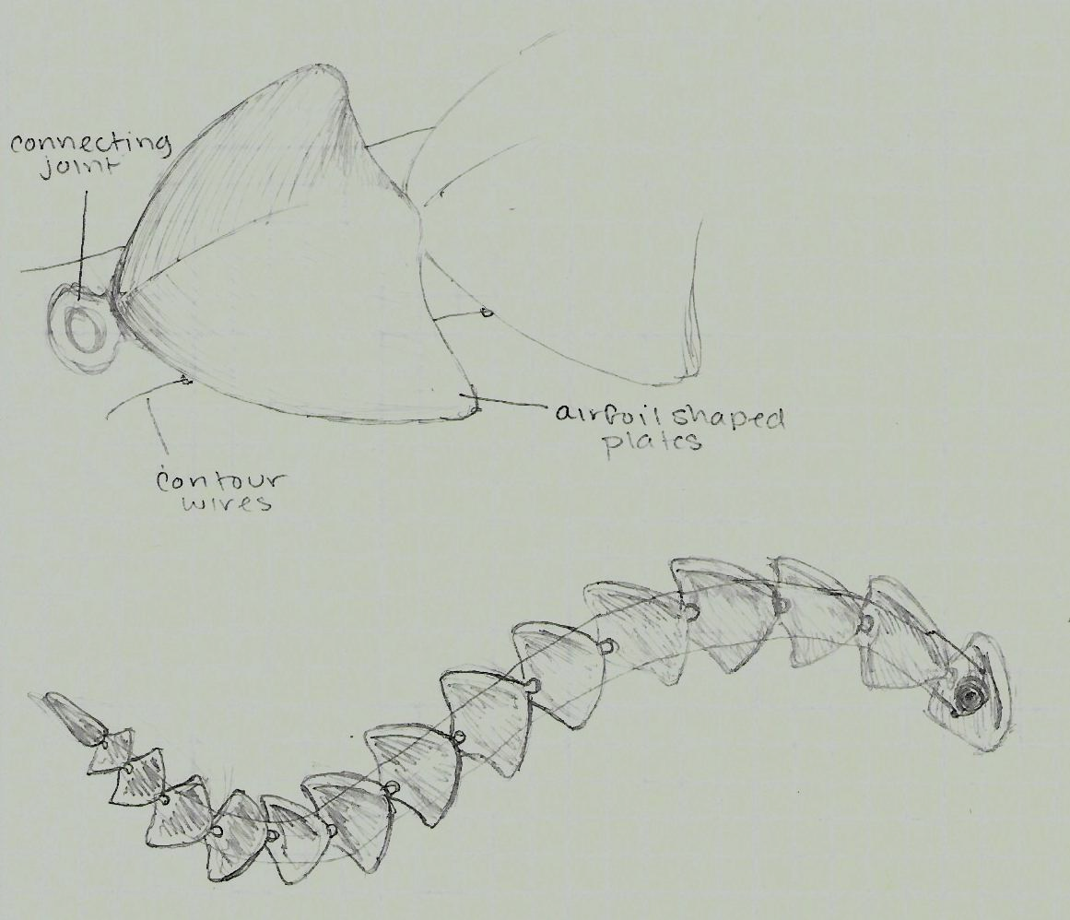
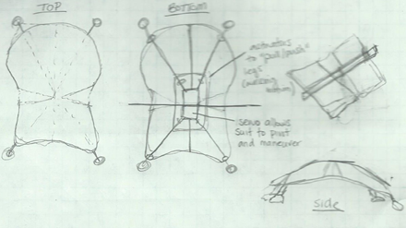
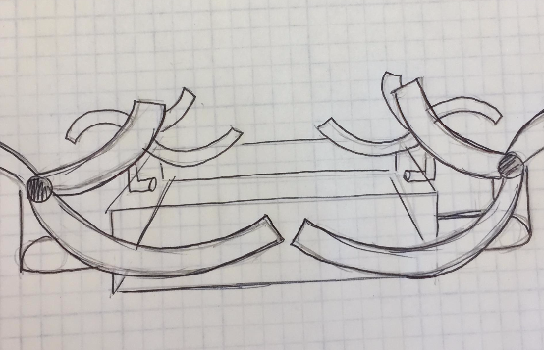
Preliminary Potential Designs
Flying Snake Sugar Glider RHex Quadcopter
Linked, airfoil shaped tiles
Actuated by one or more servo motors, used to spool cables that run through grommets underneath each tile in order to shape robot.
Main Servo in the middle that controls the frame of the robot during flight
-Motion mimics waveboard
Actuators and springs extend and distend legs to cause walking motion
Material: Parachute fabric,
lighter metal (aluminum)
Transitions between aerial and walking movement by rotating blades 90 degrees in the YZ axis
DC Motors for spinning motion, Servo motors for transitioning

Slide 9
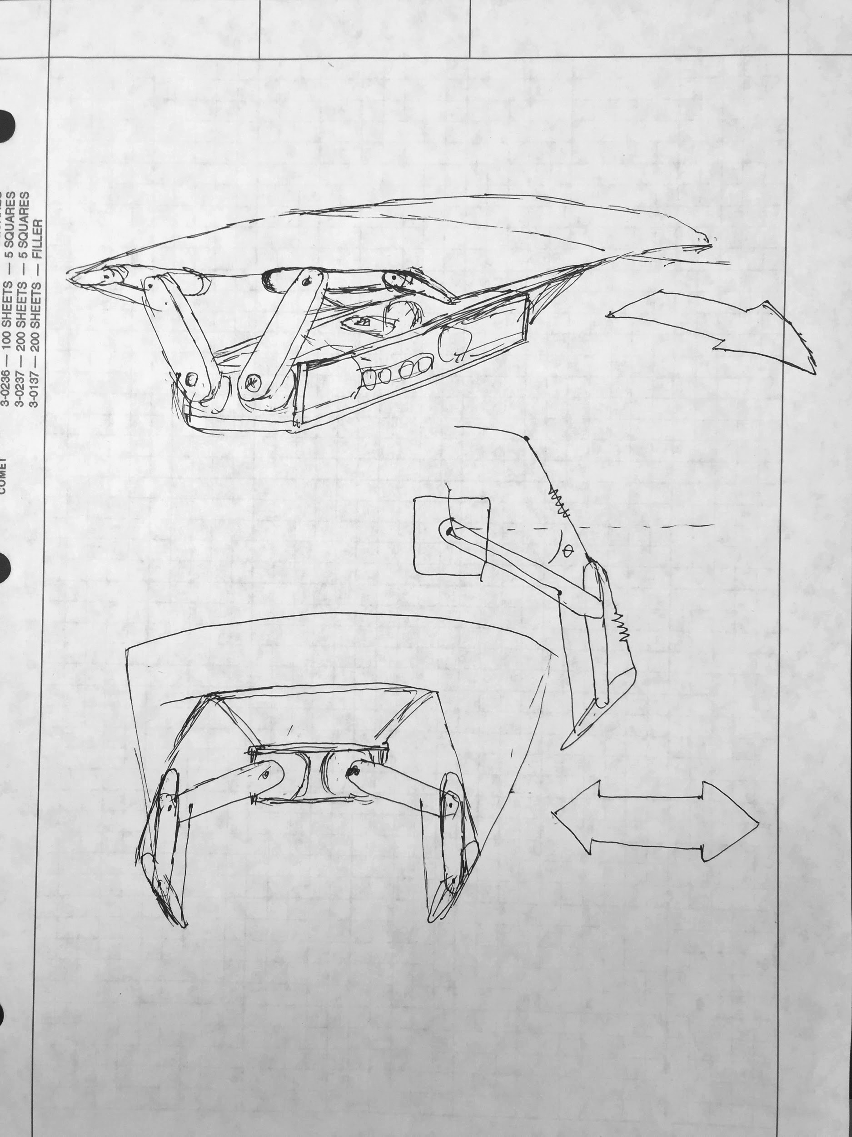
Selected Design: Crab / Bat / Sugar Glider
Overhead gliding surface with elastic properties. Uses leg manipulators to change flight surface
Most mobile: Has a set design that displays both functionality of mobility
Controllable/Reliable/Simple: Both walking and gliding movement is controlled by the same actuators.
Maneuvers frame shape to change attitude while gliding (roll/pitch/yaw)
Elastic Material
GLIDING
Elasticity Modeled by Spring
Arms fold down, stretching covering material
WALKING

Slide 10
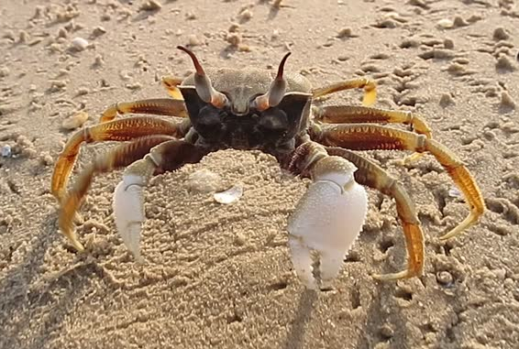
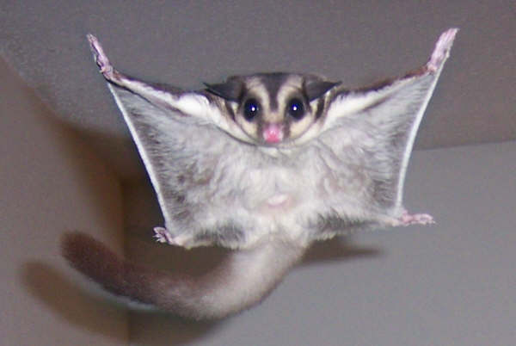
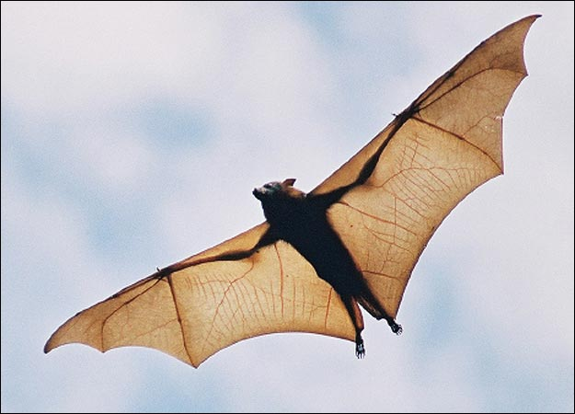
Animal Inspirations
Walking - Crab
Gliding - Sugar Glider / Bat
Walking structure and pattern allows crabs a low barycenter that “provides good stability and adaptability in low currents and billows.”
The wing structure of a bat is more efficient than birds
Flexible membrane and many-jointed wings
Adaptable multi-shifting structures
More lift, less drag = better maneuverability
Only need small adjustments for significant degree of control
Ability for prolonged flight and lift
Sugar glider shape → efficient and safe landing with minimum software needed

Slide 11
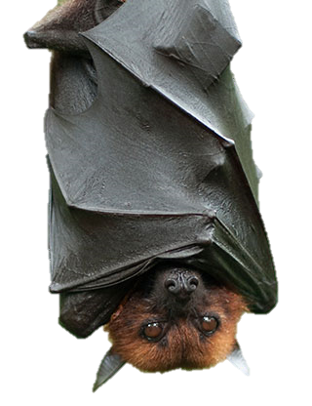
Process
Build and Test 2 Seperate Robots
1 - Ground Robot: Master Walking (Crab)
2 - Aerial Robot: (Bat / Sugar Glider)
1: Master Gliding
2: Master Gliding with Sensors
and Feedback

Slide 12
Morph Chart |  | Concepts
 |  | ((1)) | ((2)) | ((3)) | ((4))
1 | Receive and process sensor info | mbed | arduino | rasberry pi | offboard
2 | Control algorithm | Closed loop, PI | Closed loop, PID | Closed loop, P | Open loop control
3 | Output signals (of correct type, frequency, power) | produced by microcontroller | 3rd party board | homemade board
4 | Provide power for motors and controller | Duracell 9V battery | 206A 9V battery | 23A 12V battery | lipo???
5 | Control legs in walking motion | 1 DOF limbs attached to DC motors (4) | 2 DOF limbs controlled by motors (8) | 2 DOF limbs controlled with motors(6) and pulley system | 2 DOF limbs controlled with motors(4) and pulley system
6 | Control flight surface to --> bank, change angle of attack | change center of mass | change wing shape
7 | Transition between flying/walking modes | Wing struts rotate down to become legs | separate actuators for walking and gliding
8 | Sense height above ground | Range finder | External communication | Dead Reckoning
9 | Measure speed | Accelerometer | GPS | outside input
10 | Measure motor speed/position | Encoder | hall effect or inductance sensors | Measure postion of end effectors, not motors
11 | Sense orientation | Magnetic compass | GPS | Callibrate to nearby objects and sense position | Gyro
12 | move on ground | crawling | walk/running | inchworm | wheels
13 | Create sufficient lift for flying | integrated wing surface | detachable wing surface | extendable wing surface | hydostatic (eg blimp)

Slide 13
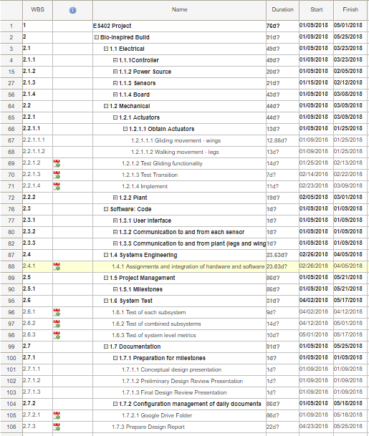
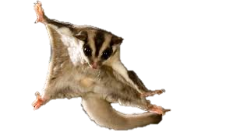
WBS: Work Breakdown Structure / Gantt Chart
lk
SPRING SEMESTER
WBS broken into 7 categories:
Electrical (11 weeks)
Mechanical (10 weeks)
Software: Code (3 weeks)
Systems Engineering (2 weeks)
Project Management (2 weeks)
System Test (4 weeks)
Documentation (5 weeks)
Approximately 11 weeks
Notes:
WBS and Gantt chart are comprehensive. Tasks are well defined and divided at a proper detail.WBS and Gantt chart are comprehensive. Tasks are well defined and divided at a proper detail.

Slide 14
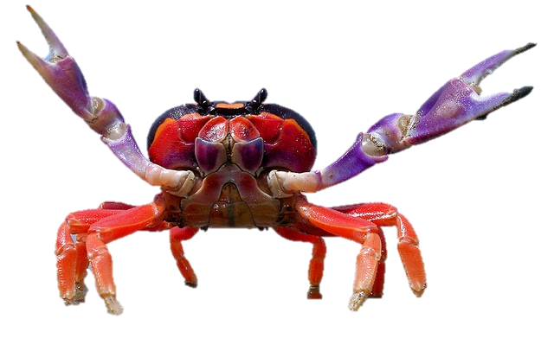
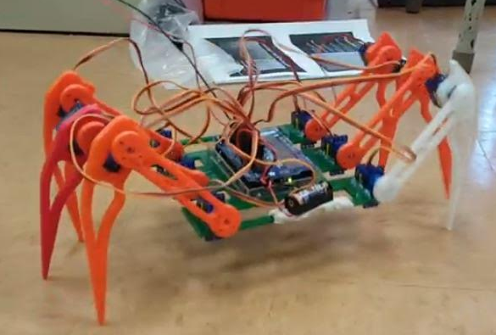
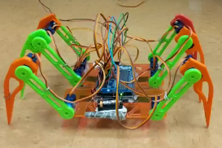
Robot 1
Ground Robot

Slide 15
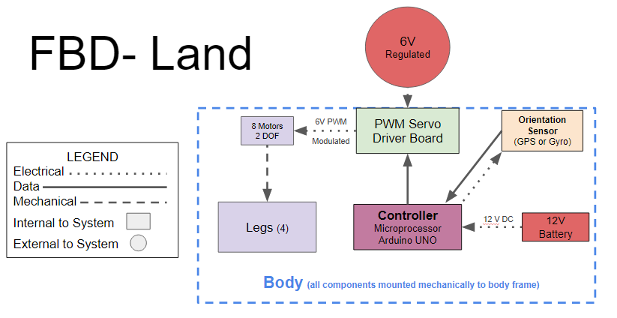

Slide 16
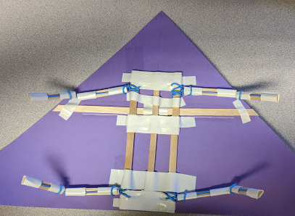
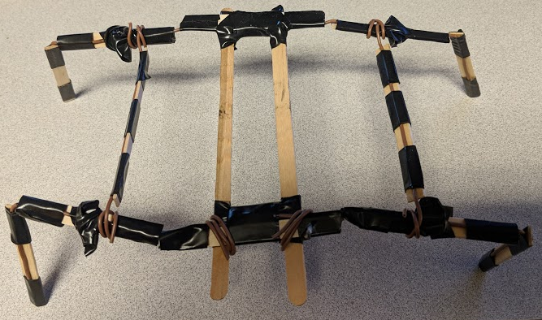
Ground Robot Preliminary Structures
Top left: preliminary walking frame; popsicle stick, wire, and electrical tape
Bottom left: sketch of walking frame with gliding mechanism
Above: first construction of potential walking and gliding structure

Slide 17
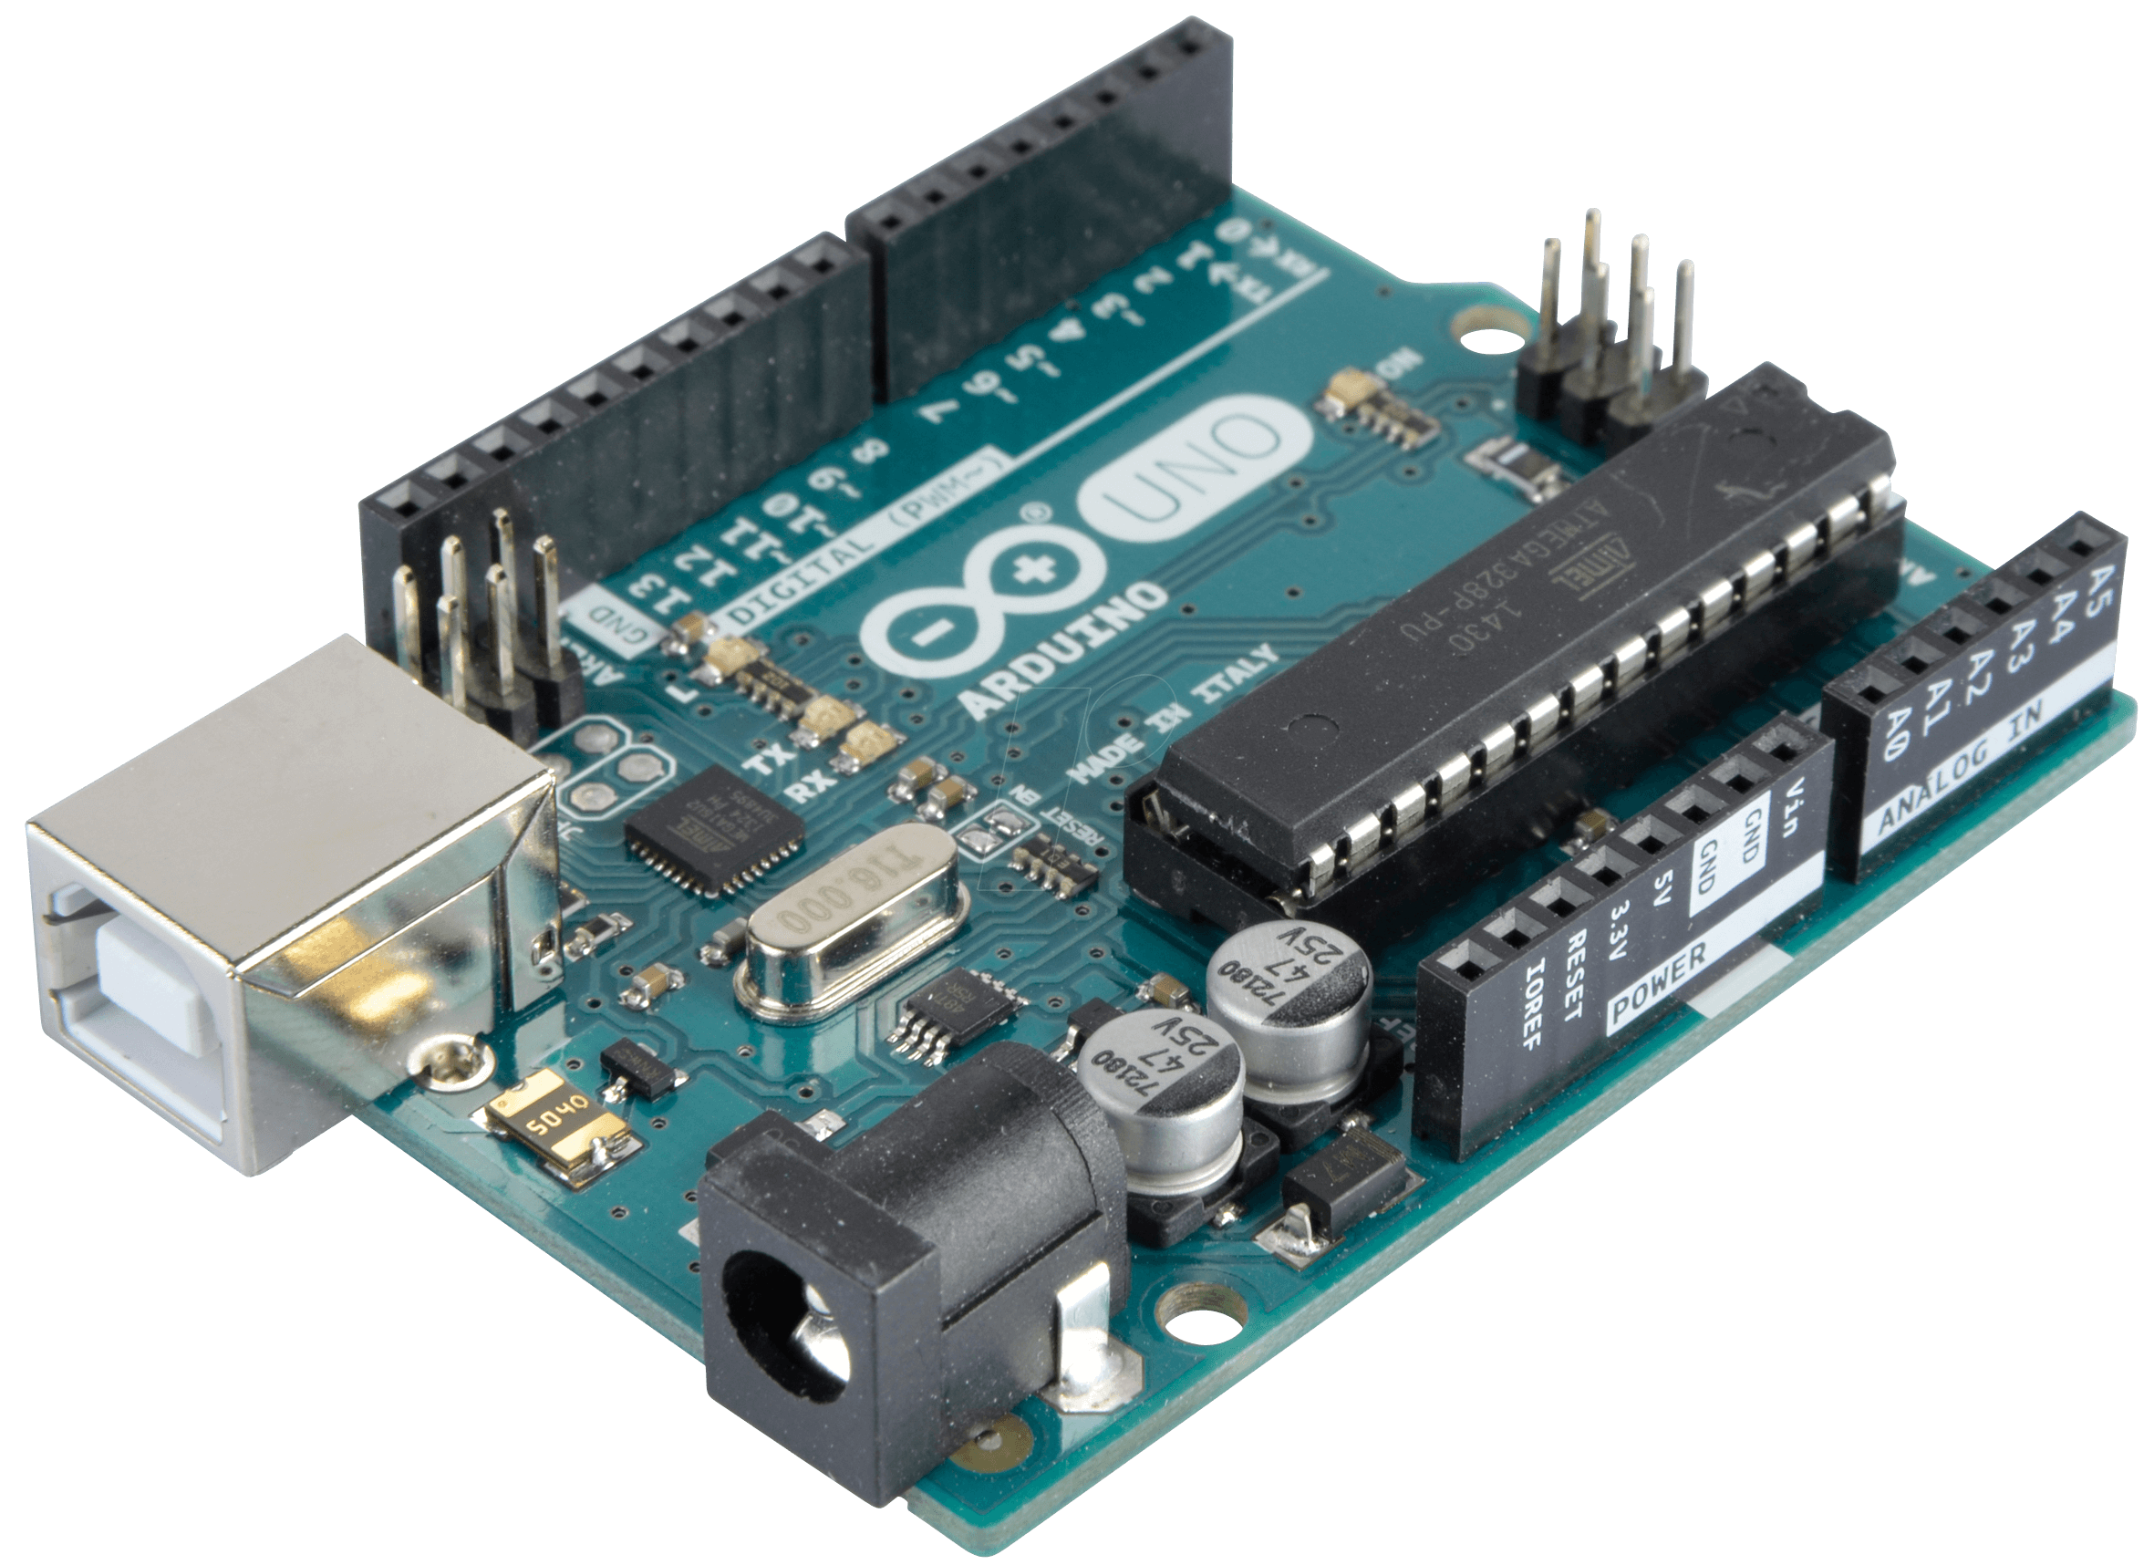
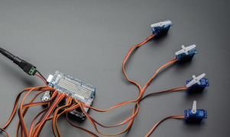
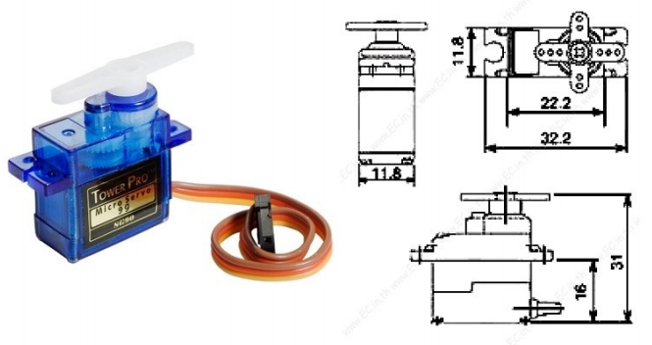
Microcontroller + Servo Shield + Micro Servos
Arduino UNO
Microcontroller board
14 digital input/output pins
6 PWM outputs
6 analog inputs
16 MHz quartz crystal
USB and power jack
ICSP header
Adafruit Servo Shield
Adafruit 16-Channel 12-bit PWM/Servo Shield
- I2C Interface
Dimensions: 2.1" x 2.7" x 0.1" (54mm x 70mm x 3mm)
I2C 7-bit addresses between 0x60-0x80, selectable with jumpers
Servo Motors (12): SG90
Weight: 9 g
Dimension: 22.2 x 11.8 x 31 mm
Stall torque: 1.8 kgf·cm
Operating speed: 0.1 s/60 degree
Operating voltage: 4.8 V (~5V)
Dead band width: 10 µs
Temperature range: 0 ºC – 55 ºC

Slide 18
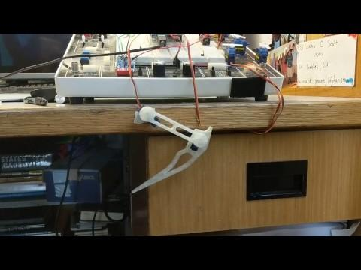
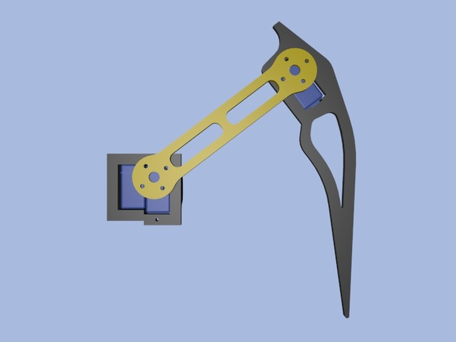
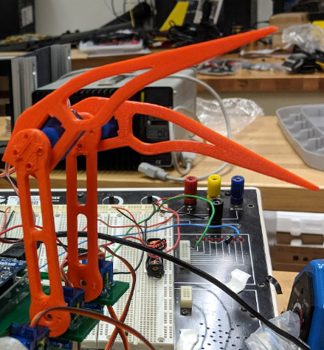
3D Printing Legs and Actuation
Legs (6): Printed on a Z18 3D Printer
Machine: MakerBot Replicator Z18
Material: Polylactic Acid (PLA) Filament
Cost: $199.67 / kg
Design: HuGoroN (Thingiverse, 2014)

Slide 19
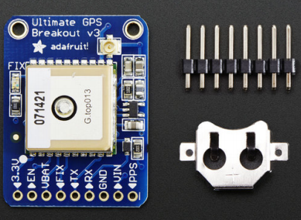
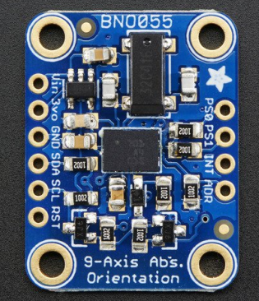
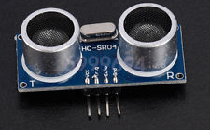
Mechanical Subsystems: Sensors
Height Sensor (HC-SR04) Speed Sensor (GPS) Orientation Sensor (BNO055)
Range: 2-4 m Satellites: 22 tracking, 66 searching Absolute Orientation (3 Axis)
Operating Voltage: 5 VDC Update rate: 1 to 10 Hz Angular Velocity Vector
Operating Current: 15 mA Position Accuracy: 1.8 meters Acceleration Vector, Gravity Vector
Operating Frequency: 40 KHz Velocity Accuracy: 0.1 meters/s Magnetic Field Strength Vector
Measuring Angle: 15 Degrees Warm/cold start: 34 seconds Temperature

Slide 20
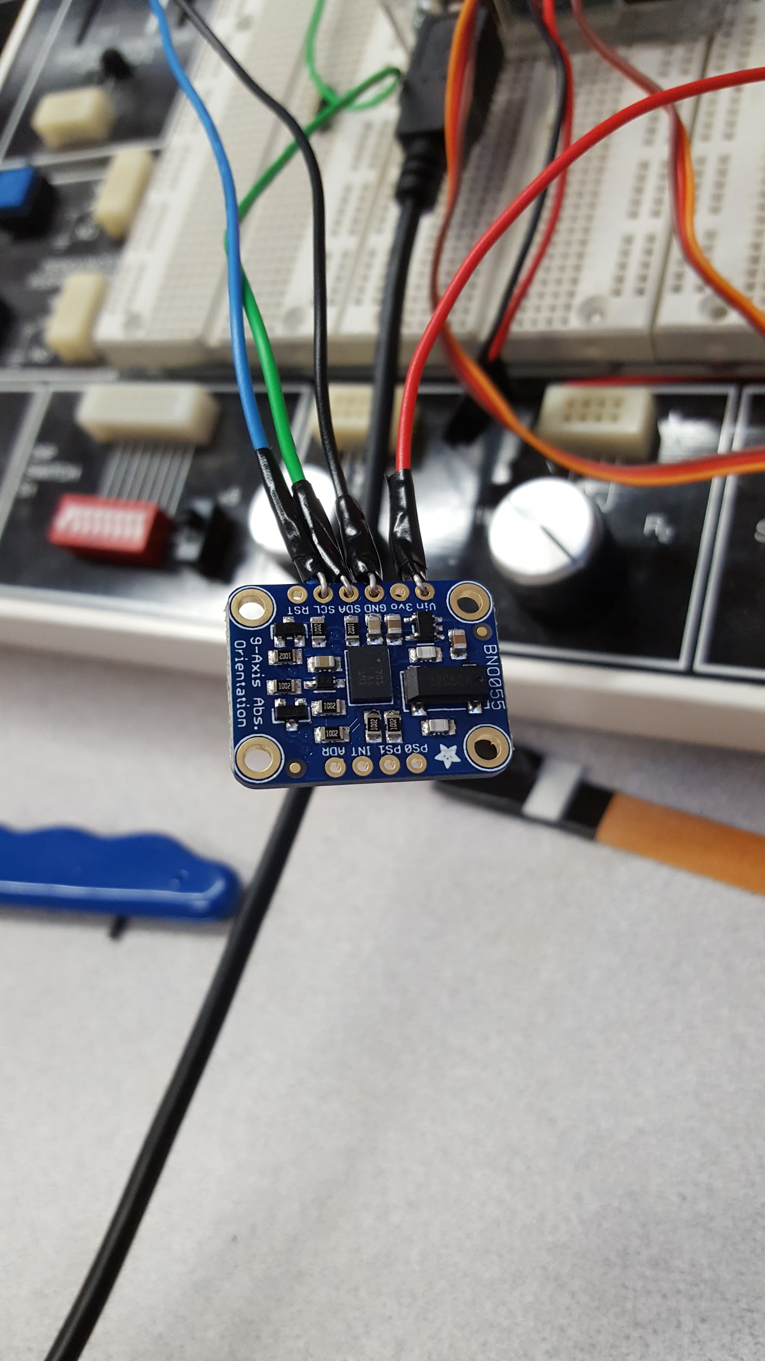
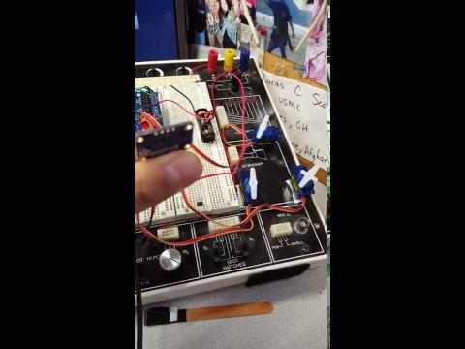
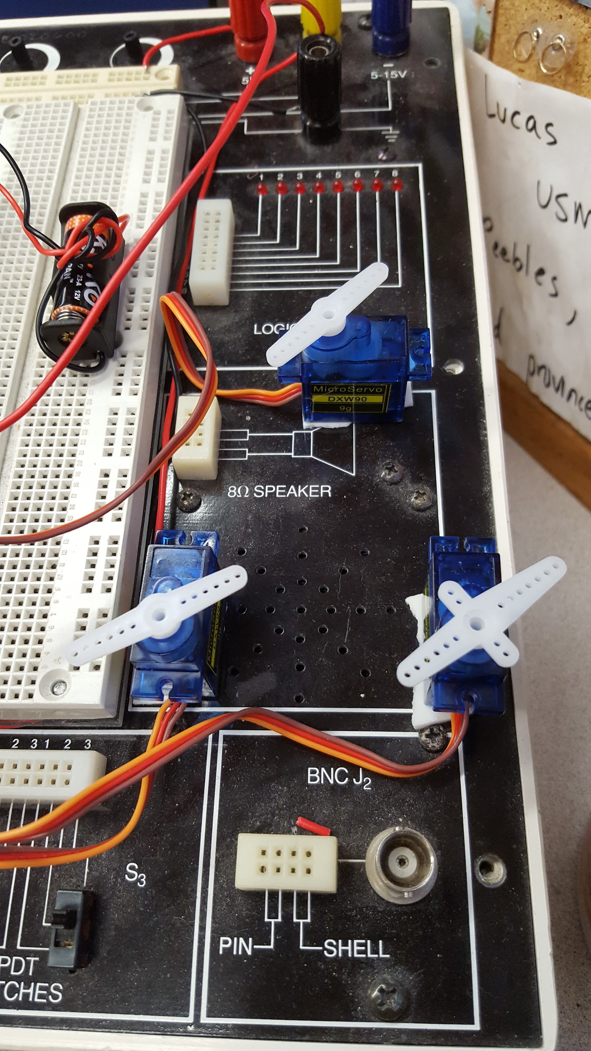
Sensors and Actuators Tests
Successfully read values from 9-DOF Sensor
Sensor is not yet calibrated
Successfully able to actuate servos
Further testing needed to accurately calibrate
Sensor Values used to control servo movement
Video of servo motion controlled by 9-DOF sensor

Slide 21
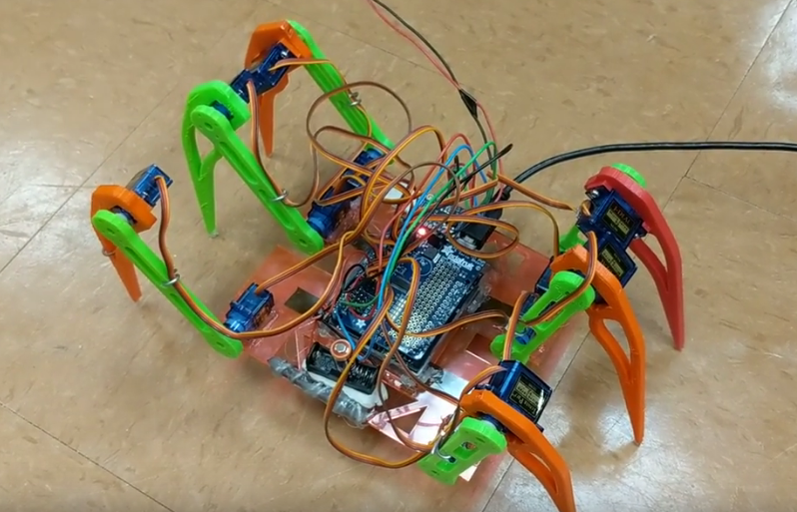
Ground Robot Design
Off Board Power Source
Orientation Sensor BNO055
USB Connector
6 x 3D Printed Legs
2 x Servos per Leg
23A 12V Battery
Arduino Uno and Adafruit Servo Shield

Slide 22
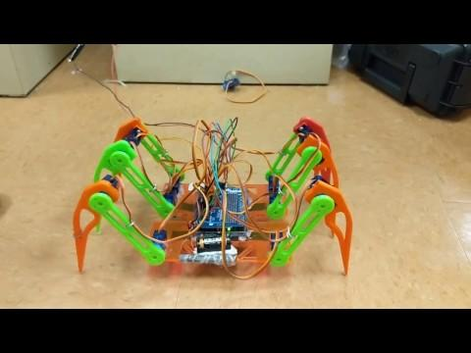
Ground Maneuverability: Motor Testing and Synchronization
Servos are calibrated to the same zero positions (left and right respectively)
Simultaneous and exact motion can be matched in each leg and servo motor

Slide 23
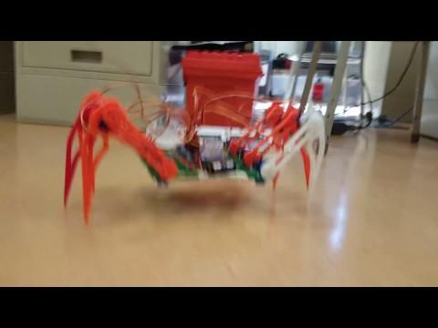
Ground Maneuverability: Walking
Walks steadily back and forth
Able to make wide turns by varying outside motors
Variable speed, more control at slower speeds

Slide 24
Ground Maneuverability: Attitude Stabilization
Controls roll, pitch, and yaw with servo-leg movements
Legs keep body frame in upright position based on readings from the orientation sensor

Slide 25

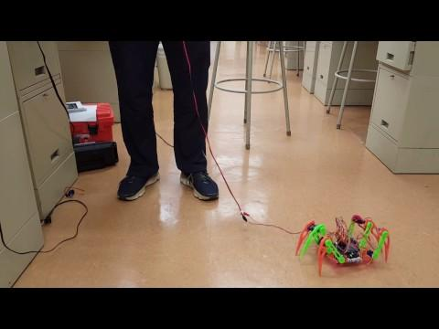
Ground Maneuverability Results
Turning
Metrics Met
Mobile: 4/4
Controllable: 3/4
Simple: 4/4
Durable: 2/4
Inexpensive: 3/4
Range of capabilities and movements programmable
Off board power source
Can self-stabilize attitude using orientation sensor
Servo arms shift, morphing the walking into gliding model

Slide 26
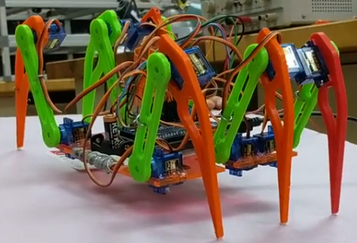
Ground Movement → Progression for Legacy Project
Future Payload:
Camera for ISR
Batteries to increase survivability of a ground unit
Needs higher torque servo motors and overall more robust design
Can be inserted in operational areas
Small and silent footprint
Multiple methods of maneuverability
Dropped from the sky and covertly navigate

Slide 27


Robot 2
Aerial Robot

Slide 28


Preliminary Gliding Designs

Slide 29




Aerial Testing: Center of Gravity
Weight in Front
Weight in Middle
Weight in Back

Slide 30


Without Sensors
With Sensors

Slide 31


Aerial Robot Design
Wing Loading: 1.71 kg/m^2
Kite Material
Kite material surface supported by flexible carbon fiber rods glued to underside.
Same Body as Ground Robot

Slide 32

Moving the Wing Surface

Slide 33


Aerial Movement → Progression for Legacy Project
Results
Lessons Learned and Progression
Weight was too heavy for kite material
Joints and legs cannot withstand 7 foot drops
Next Steps Forward
Gliding and Stabilization
Navigation and Directional Movement
Payload Capabilities
Metrics Met
Mobile: 2/4
Controllable: 0/4
Simple: 4/4
Durable: 0/4
Inexpensive: 4/4

Slide 34
Budget and Expenses
Labor | Hours
MIDN Labor (x1) | 54
MIDN Labor (x4) | 216
Faculty Labor | 36
TSD Labor | 7.82
Materials Costs per Robot |  |  | Total
23A 12V Battery |  |  | $ 5.95
12V 23A Battery Spring Clip Black Plastic |  |  | $ 7.89
18" Delta Kite - Test Kite 1 |  |  | $ 11.27
Kite Fabric (60" x 36") |  |  | $ 8.95
4' Shark Kite - Test Kite 2 |  |  | $ 15.48
9g Micro Servo Motors (Legs+Wings) |  |  | $ 17.99
Adafruit ADXL335 - 5V ready triple-axis accelerometer |  |  | $ 15.47
Adafruit 9-DOF Absolute Orientation IMU Fusion Breakout - BNO055 |  |  | $ 30.49
Adafruit Ultimate GPS Breakout - 66 channel w/10 Hz updates |  |  | $ 38.97
Ultrasonic Height Sensor 1 - HC-SR04 Dual |  |  | $ 4.49
Adafruit 16-Channel 12-bit PWM/Servo Shield - I2C interface |  |  | $ 15.49
3x4 Right Angle Male Header - 4 pack (for servo interface) |  |  | $ 14.97
Carbon Fiber rods and strips |  |  | $ 30.63
 |  | Total | $ 218.04

Slide 35


Huge Thank You To:
Questions?
Joe Bradshaw
and Dan Rhodes
and all of USNA TSD
Lockheed Martin
and the Naval Academy Foundation

Slide 36


Slide 37


